Slide 1
Natural Language Understanding with Indirect Supervision
Daniel Khashabi
Notes:
Thanks for having me here.
First time time on CMU campus and very happy to be here.

Slide 2
Age of Big Data
Big data:
Over 56 billion pages
Over 500 million tweets are sent every day.
Over 4 million blog posts are published on the Internet every day.
Deep learning:
1.5 billion parameters [Radford et al. 2019]
Super-human performance [Devlin et al. 2018]
Notes:
To begin, here is where we are today:
- We tons of data, lots of text, videos, images, whatever you want. We don’ even know where to store these.
And fortunately we have deep learning:
- Tons of parameters, huge number of layers to really soak of the available
- And it has led to performance boosts across a range of tasks.
What else we could we possibly want? It seems that everyone should be pretty happy.
===================
(and I can just conclude the talk right here and spare you an hour).
Note: the last sentence and of this slide you should look happy and smiley.

Slide 3
Troubling Observations
Brittleness with respect to small changes
[K at al. 2016; Jia et al. 2017; Ribeiro et al. 2018; others]
Context: In the United States especially, several high-profile cases such as Debra LaFave, Pamela Rogers, and Mary Kay Letourneau have caused increased scrutiny on teacher misconduct.
Question: What has been the result of this publicity?
“increased scrutiny on teacher misconduct”
What’s
“teacher misconduct”
Notes:
Well, ... alongside the apparent progress, there are troubling trends as well.
You take a SOTA system, run it on an instance taken it is used to seeing and things work well.
You make small changes to the instance, and things fall apart.

Slide 4
Scenarios with Little (no?) Supervision
Majority of our success has been on tasks w/ abundant annotations.
And tasks with little annotated data get the least attention.
There will be settings where there is not “enough” direct supervision.
Unseen/unexpected scenarios.
Change of style, context, domain, etc.
These all result in vast space of possibilities for meanings.
Notes:
And more broadly speaking, part of the problem is our over-reliance on annotated data.
Most of the advances are on problems with abundant directly annotated data.
- And there is relatively little progress on problems with small annotations.
And this is a problematic trends, since:
There will always be settings/problems where we will not have enough direct supervision/annotation.
-...
- ...
- which all go hand in hand to form a massive space of possible meanings in natural language.
And in fact you can view the previous slide (failures under perturbations) in this light.

Slide 5
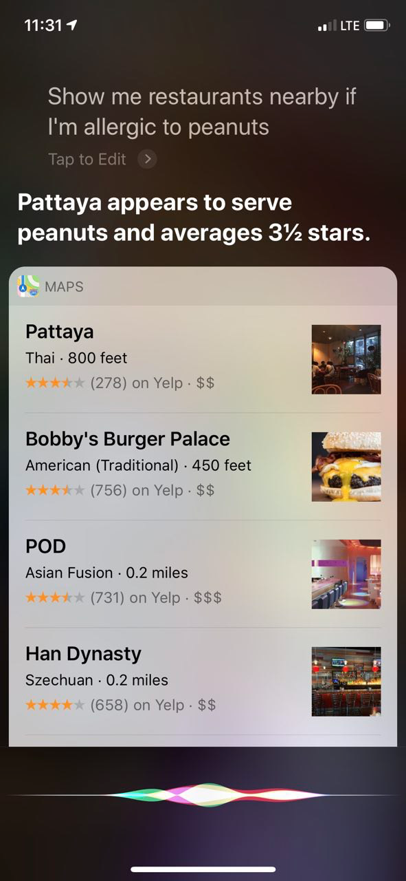

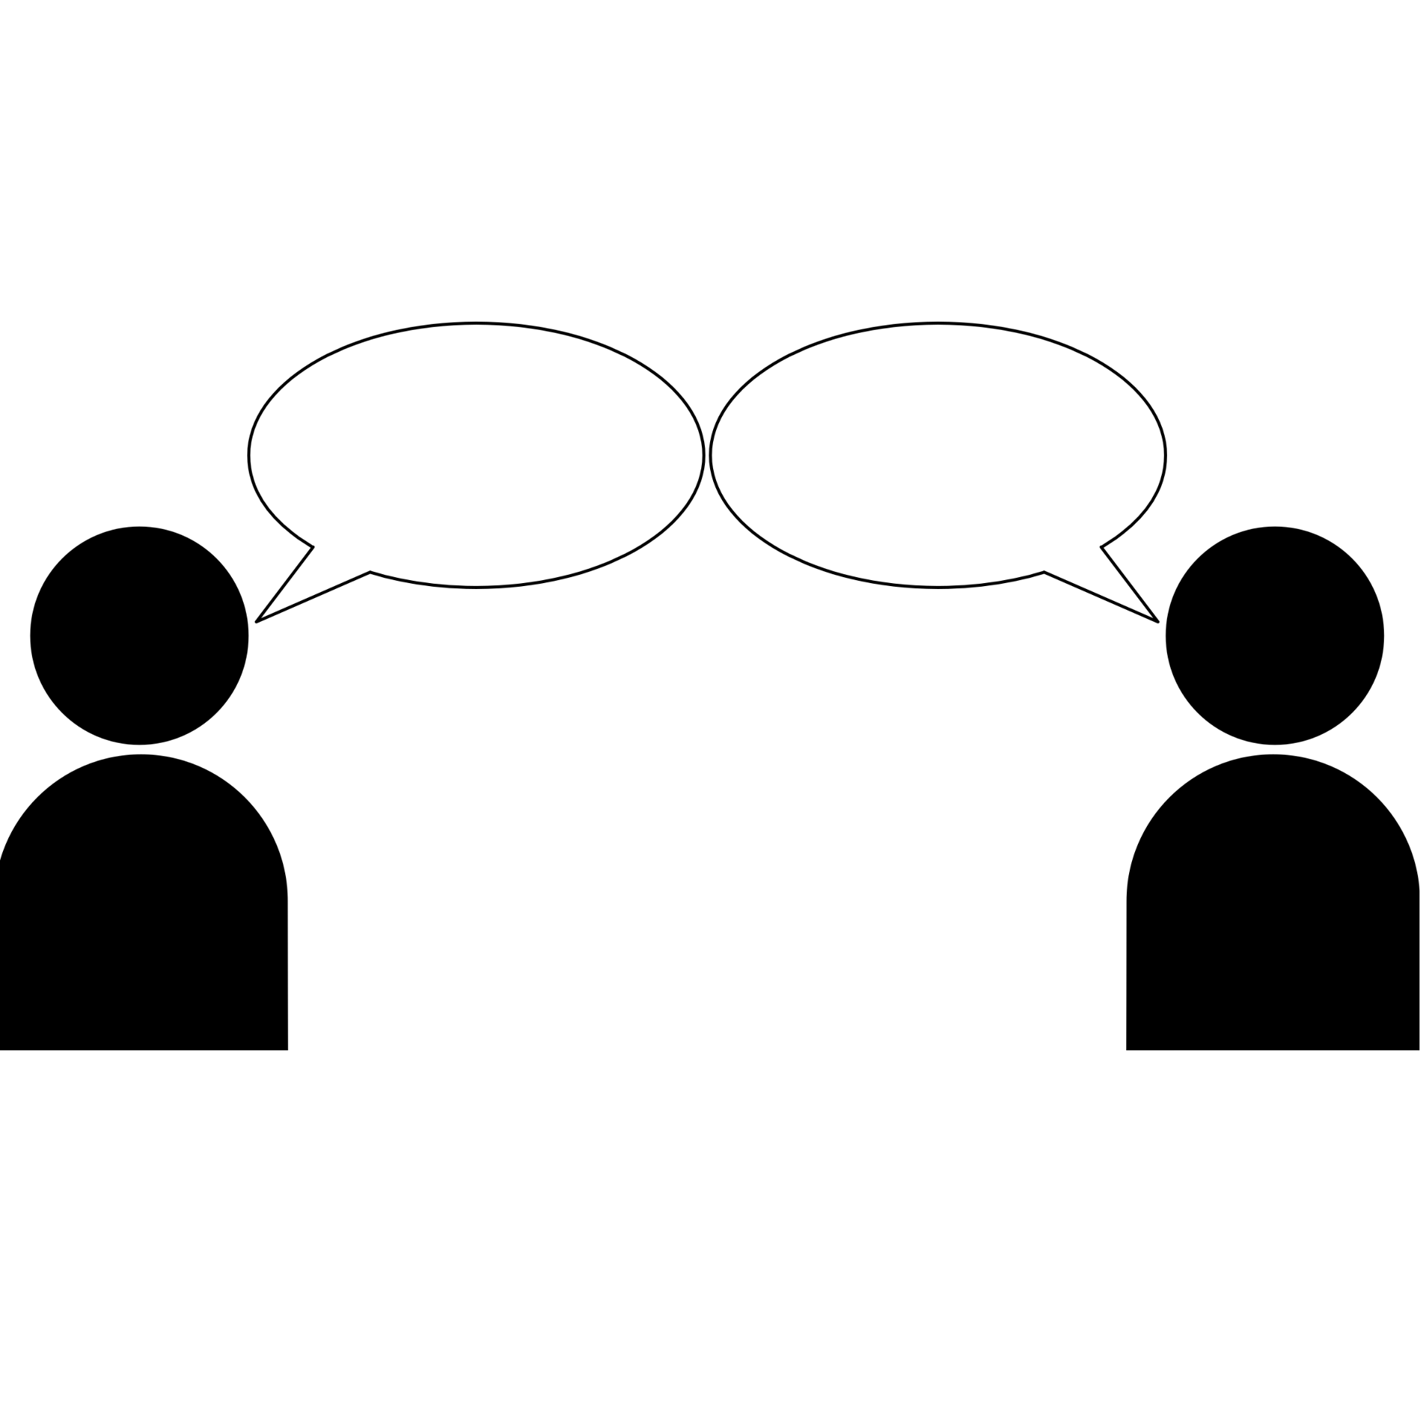
Show me some restaurants nearby.
Here are some options I found nearby:
….
I am allergic to peanuts.
I don’t like crowds.
Notes:
Imagine a conversation with your futuristic natural language assistant.
You ask your system: ....
And it responds by giving a few options. So far, so good, since we have really good retrieval systems that work based on shallow keywords.
But then you remember that you have to specify something else about your order.
For instance you say .....
But how would you go about teaching a machine what “peanut allergy” is and what to do in such situations.
Would you annotate a big pile of training data, in order to teach a machine about “peanut allergy”?
Would that generalize, because there are many other similar phrases that can be used here, instead of peanut allergy.
=================
Even if you do so, I can replace this last query with many other possible replies, each of which require a particular way to address. For instance I can say ...

Slide 6
Talk Statement
It’s unlikely that we will have directly “annotated” data that cover all aspects of natural language understanding.
Data provides “hints” that exist independently of the task at hand.
Weak signals can be amplified to produce higher quality signals.
Requires effective use of representation, knowledge and putting them together.
Notes:
And as I argue in this talk ...

Slide 7
This talk
Abb
Annotated
Data
Notes:
To channel a little symbolism here, as I mentioned, the field has been riding the wave of tasks with much annotated data.
However if your goal is to explore the ocean, it’s not clear if you can rely only on waves to get you everywhere.
And in this talk, we turn our attention to parts of the water that do not have big waves. But we will find ways to use smaller waves (and other forces) to be able to navigate.
================
Well, you all have seen many people enjoy riding on waves on certain parts of the shore.
However if your goal is to explore the ocean, there is much more to ocean than places that let you ride the waves.
And there is a strange parallel between how the field has been riding the wave of supervision for annotation-rich problems.
But that’s not what this talk is about: this talk is about the parts of the ocean where there is not much wave. In other words, the problems for which we do not have much supervision.

Slide 8

“Supervision” vs “Data”
Minimal
Abundant
Supervision (direct annotations)
data
Notes:
And just to be clear about the terminology, I am distinguishing between "data" and "supervision":
(1) In a machine learning terms, in particular supervised learning, data comes as pairs of input-output pairs. When I talk about supervision, I am talking about the x-y pairs. (for instance, for the task of mapping documents with their labels)
(2) When I say “data” this is what I am talking about: a large collection of data, for instance freely available text documents, possibly with some structure that you get for free.
Left: minimal.
Right: abundant.

Slide 9
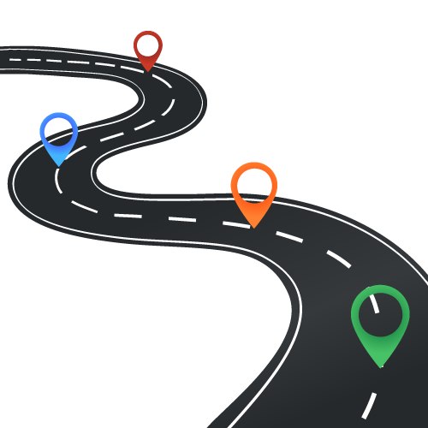
This talk
▣ Introduction
▢ Answering Questions
▢ Semantic Typing of Entities
▢ Future Work
with minimal supervision
Representations
Wikipedia
Structure of the problem
Compositionality
Other learned models
…
Notes:
In this talk, I will go over two different tasks in the context of natural language.
Both of which have traditionally tackled with lots of supervision; however, our approach is going to assume minimal supervision.
...
Finally, I will end the talk with a little discussion of,
-the big picture, future work and a few things I am excited about.

Slide 10
ANSWERING QUESTIONS with minimal supervision
K et al. Question Answering as Global Reasoning over Semantic Abstractions. AAAI 18.
K et al. Question Answering via Integer Programming over Semi-Structured Knowledge. IJCAI 16.
Clark, EKSTTK. Combining Retrieval, Statistics, and Inference to Answer Elementary Science Questions. AAAI 16.
Notes:
In the first part of the talk I am

Slide 11



Why Answering Questions?
The grand goal: Natural Language Understanding (NLU).
Measuring progress by answering questions.
A system that is better at understanding language should have a higher chance of answering questions.
This has been used in the field for many years. [Winograd, 1972; Lehnert, 1977b; others]
Question Answering (QA), Reading Comprehension (RC), Textual Entailment (TE), etc.
Notes:
A grand goal for us is to enable machines understand and interpret natural language, just like how humans would do.
It's been argued that answering natural language questions could be used as proxy to measure our progress towards NLU.
if an actor (human or computer) understands a given text, it should have a higher chance of answering questions about it.
This has been used in the field for many years, under different names and variations.

Slide 12
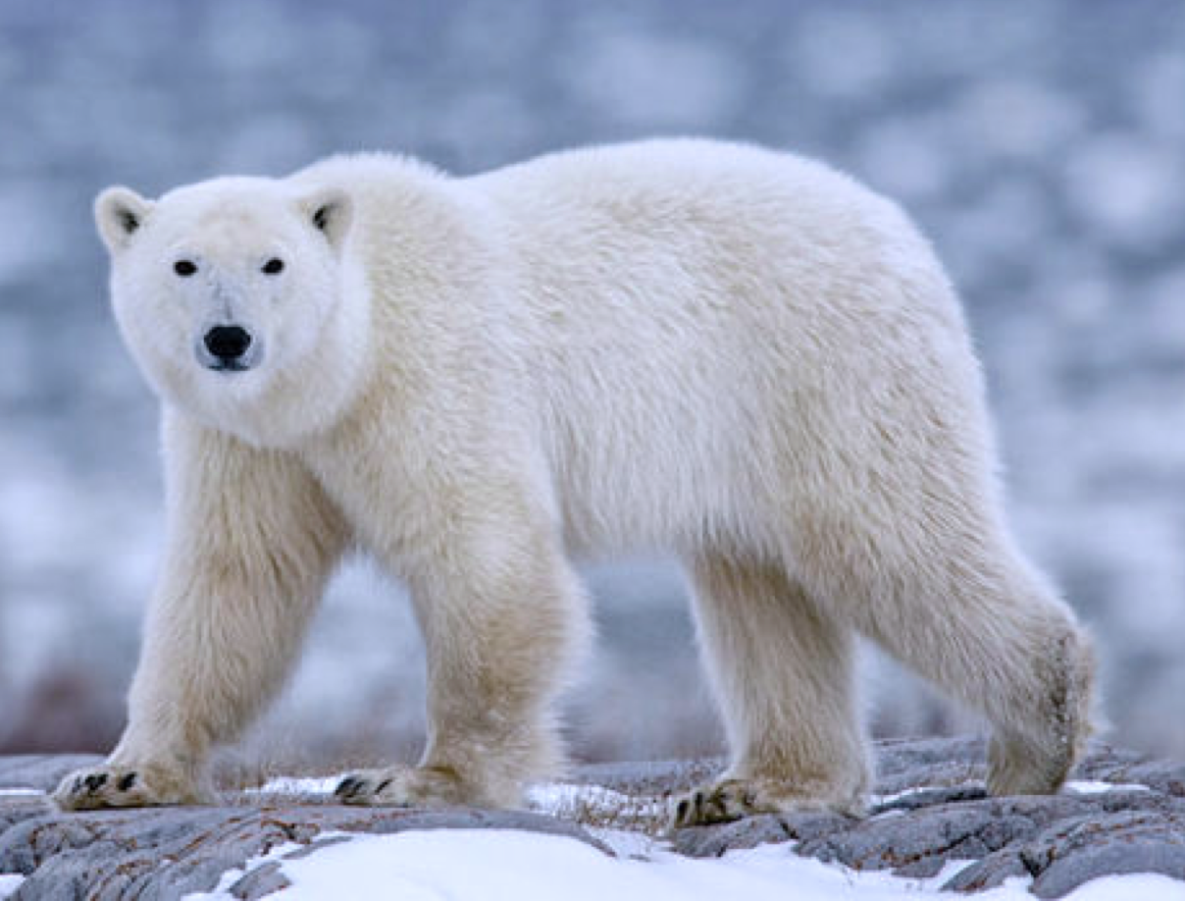
Answering Questions: The Setting
Standardized science exams. [Clark et al. 2015]
Simple language; machines require the ability to use the knowledge and abstract over it.
Question: A bear survives winters with what structure?
+
(A) big ears
(B) black nose (C) thick fur
(D) brown eyes
Attached to each question is an evidence paragraph, potentially with the answer to the question.
+
Notes:
And in particular, we are going to be working with elementary school science exams which are proposed as challenges for NLU.
Let me read you an example I am showing you here: ….
Attached to each question are paragraphs of text, which provide hints about the answer to the question.
These are the tests that are designed for humans; and we take the tests as is, give it to machines and try to pass it.
And for a machine to solve it, it has to be able to abstract over language, do some reasoning in order to get to the answers.
===========
The questions do not come with any extra knowledge; instead the solver must be equipped with world knowledge about elementary school science.
For each question, there is a relevant text, which potentially contains the answer. Figuring out the answer from this text, often requires relatively deep understanding.
For the rest of the talk, I will use this example as the running example.
For the rest of the talk, I will use this example as the running example.
# which are proposed to assess the progress in language understanding in a measurable way.
# Take the test as it is, just as we give it to humans and pass this exam.

Slide 13
Linguistic Variability
Question: A bear survives winters with what structure?
+
(A) big ears
(B) black nose (C) thick fur
(D) brown eyes
Evidence paragraph
… and a bear survives winters using its thick fur …
Notes:
Take the science example we discussed in the first slide:
The text containing the answer to this question, can be expressed in a simple way. (Read the first text)
Almost a combination of a phrase from the question and the correct answer

Slide 14
Linguistic Variability
Question: A bear survives winters with what structure?
+
(A) big ears
(B) black nose (C) thick fur
(D) brown eyes
Evidence paragraph
... Polar bears, saved from the bitter cold by their thick fur coats, are among the animals in danger of extinction because of global warming and human activities. …
A given “meaning” can be phrased in many surface forms!
Notes:
In reality, language often is often not that simple, since facts can be phrased in arbitrary complex form (part of a larger paragraph):
(read the text)
How would you handle such scenarios? Let’s take a closer look.
=============================
# Of, course, this can be said also in a simple way—show and animation—but it so happens that in many cases people say it has n more interesting and complex ways. QA is really a language understanding task and we need to abstract over the surface representation.

Slide 15
Linguistic Variability
Question: A bear survives winters with what structure?
+
(A) big ears
(B) black nose (C) thick fur
(D) brown eyes
Polar bears have white fur so that they can camouflage into their environment. Their coat is so well camouflaged in Arctic environments that it can sometimes pass as a snow drift. They have a thick layer of body fat, which keeps them warm while swimming, and a double-layered coat that insulates them from the cold Arctic air.
Polar bears, saved from the bitter cold by their thick fur coats, are among the animals in danger of extinction because of global warming and human activities. Polar bears’ lives depend wholly on the sea, their main source of food, and the place they spend most of their lives. But as the climate warms, that ice is melting, threatening polar bears. A common method of hunting by polar bears involves the bear keeping perfectly still by a seal's breathing hole, waiting for hours—or even days—for a seal to pop up for air.
Evidence paragraph
Notes:
In reality, language often is often not that simple, since facts can be phrased in arbitrary complex form (part of a larger paragraph):
(read the text)
How would you handle such scenarios? Let’s take a closer look.
=============================
# Of, course, this can be said also in a simple way—show and animation—but it so happens that in many cases people say it has n more interesting and complex ways. QA is really a language understanding task and we need to abstract over the surface representation.

Slide 16
A Common Approach: Supervised Learning
Input: question, an evidence paragraph.
Output: predicted answer.
Much success: Mostly with abundantly annotated data.
Things can break down!
Question: A bear survives … ?
“thick fur coats”
Evidence paragraph
Notes:
A common approach to this problem is to use supervised learning. Choose your favorite supervised learning architecture, and train its parameters with a large space of parameters given many input-output pairs.
And such systems can go a long way. A highlight of the past years has been the success of such models, especially when trained on abundantly trained annotations.
And things can break down, especially when you change the wording, style, vocabulary, etc.
In particular, if you run BiDAF on the instance that I showed you before …

Slide 17
Question: A bear survives winters with what structure?
Polar bears have white fur so that they can camouflage into their environment. Their coat is so well camouflaged in Arctic environments that it can sometimes pass as a snow drift. They have a thick layer of body fat, which keeps them warm while swimming, and a double-layered coat that insulates them from the cold Arctic air.
Polar bears, saved from the bitter cold by their thick fur coats, are among the animals in danger of extinction because of global warming and human activities. Polar bears’ lives depend wholly on the sea, their main source of food, and the place they spend most of their lives. But as the climate warms, that ice is melting, threatening polar bears. A common method of hunting by polar bears involves the bear keeping perfectly still by a seal's breathing hole, waiting for hours—or even days—for a seal to pop up for air.
Can we “explain” the decision?
Can we “fix” such behaviors?
Predicted Answer
[Fetched on March 26, 2019]
https://demo.allennlp.org
[Seo et al, 17, Gardner et al, 18]
Notes:
In particular, if you run BiDAF on the instance that I showed you before it selects "polar bears" as the answer to this question.
How can you now fix this system: would you create an annotated QA dataset for polar bear questions?
This not only shows a failure example, but also helps me point out the issue about "explanations" (the model makes mistake, but it's hard to make sense of what goes wrong).
But the issue is not about who gets it right or right; the issue is where do we go here? - Is there any way to look into the model and explain what went wrong?
- Moreover, how would you fix a system that is making such mistakes? Would you annotate a QA dataset that focus on issues related to “polar bears”? Maybe, but is that going to scale up?

Slide 18
Semi-Structured Inference: High-level View
Question Answering
Knowledge Representation
Structured,
yet flexible
Question Answering
as Global Reasoning
over Semi-Structured Knowledge
Reasoning
Effective, scalable
Notes:
Moving towards a solution:
if I want to show you a big picture, it's gonna have two main blocks.
one, how you represent the knowledge and how do you reason about them.
# For example, when we talk about New York, what kind of data-structures help you represent the related information.
# One point I want to emphasize is that, we want to some form of structure in knowledge, while not sacrificing flexibility at the cost of specificity.

Slide 19
Language Understanding Phenomena
verb
Question: A bear survives winters with what structure?
+
(A) big ears
(B) black nose (C) thick fur
(D) brown eyes
comma
preposition
Evidence paragraph
Polar bears, saved from the bitter cold by their thick fur coats, are among the animals in danger of extinction because of global warming and human activities.
QA is fundamentally a NLU problem
Notes:
There are many details that have to be understand.
In the question “to survive” is conveying the same information as “save from”.
Comma is important: it is conveying equivalence between what comes before and after it: “Polar bears” are indeed the “saved from”.
“By” is a preposition that shows an action done by an agent: “saving from cold” is done by “their thick fur”.
- QA is really a language understanding task and we need to abstract over the surface representation. - You really need to UNDERSTAND the language at some level to actually answer many of the questions.
------------
What we see here is not an edge case; it’s so happens that in many real examples, facts are written in more interesting and complex form. Language is ambiguous and variable and one of the characteristics of this domain is that they actually happen.

Slide 20
“Lifting” Meaning as Semantic Graphs
action
location
Oxford English Dictionary lists 8 primary meanings for “by”.
Location of action
saved from the bitter cold
by
the river
action
agent
Disambiguation!
Agent of action
saved from the bitter cold
by
their thick fur coats
Evidence paragraph
... Polar bears, saved from the bitter cold by their thick fur coats, are among the animals in danger of extinction because of global warming and human activities.
Preposition Semantic Roles
[Srikumar & Roth, 2013]
Notes:
And the field has studied each of these phenomena in language over the years.
For instance, the field has developed tools to help us better understand the structure around the proposition "by" (preposition semantic role labelers).
For this example, the extracted structure would look like something like this:
- "saved from the bitter cold" is an "action" that is done by the "agent", "their thick fur".
(maybe started here refer to it as a node-graph structure / or a predicate-argument graph; nodes representing mentions and edges representing some semantic connections between them).
These graphs are results of a disambiguation process: Identifying the agent performing an action.
And depending on the semantics of the arguments here, the meaning of the structure would also change; for instance:
A historical highlight that, the structures that I use here (and in the next few slides) are not particularly new; in fact, the idea of mapping natural language to limited set of semantic roles goes back a few decades:
In particular, it has roots in "frame semantics" which was developed by pioneers like Minsky and Fillmore.

Slide 21
“Lifting” Meaning as Semantic Graphs
mention
description
apposition structure
Polar bears
,
saved from the bitter cold
Evidence paragraph
... Polar bears , saved from the bitter cold by their thick fur coats, are among the animals in danger of extinction because of global warming and human activities.
Comma Semantic Roles
[Arivazhagan et al. 2016]
Notes:
You can something similar, by extrracting semantic roles of "comma"s.

Slide 22
“Lifting” Meaning as Semantic Graphs
Question: A bear survives winters with what structure?
+
(A) big ears
(B) black nose (C) thick fur
(D) brown eyes
live despite circumstance
a bear
survive
a winter
what structure
survivor
adverse circumstance
Verb Semantic Roles
[Punyakanok et al. 2008]
Notes:
And finally you can understand the semantics of the event asked about in the question.
-

Slide 23
Semantic Representations Altogether
Question Instance
a bear
survive
a winter
what structure
Question
survivor
adverse circumstance
Paragraph
Candidates
action
agent
mention
description
Polar bears
,
saved from the bitter cold
saved from the bitter cold
by
their thick fur coats
(A) big ears
(B) black nose
(C) thick fur
(D) brown eyes
Notes:
And putting all these semantic representations together you form a big picture different mentions in the text and how they are related to each other.

Slide 24
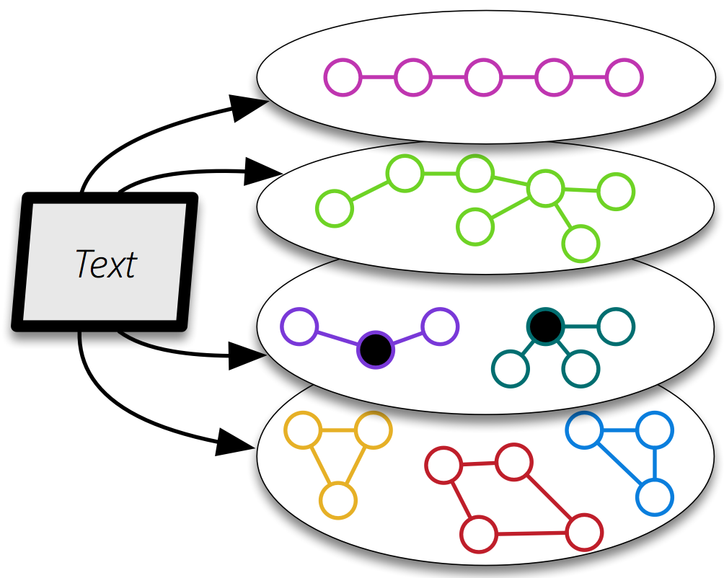
Collections of Semantic Graphs
available in our software pipeline.
K et al. LREC’18
Create a unified representation of families of graphs
Verb Semantic Roles
Preposition Semantic Roles
Comma Semantic Roles
Coreference
…
[Punyakanok et al. 2008]
[Srikumar & Roth 2013]
[Arivazhagan et al. 2016]
[Chang et al. 2012]
Our representation is not QA-specific. It reflects our understanding of the language
- Surface word
- Semantic labels
- Other representation
- …
Consequently, we expect these representations to be useful for a range of tasks
Notes:
To show you the big picture, we form an abstraction of text, as a collection of semantic graphs.
- Each instantiation of the graphs, can contain a different phenomena over text, with nodes being mentions within your text.
- Nodes could contain embeddings/representations that will be used during the reasoning time to create alignments.
I’d like to emphasize that such representations has nothing to do with the QA task. It is purely generic, and it reflects an understanding of the language. consequently, we expect these representations to be useful for a range of tasks;
============
also, they are to be learned from/as part of/ a range of tasks.

Slide 25
Support Graph
Question Instance
a bear
survive
a winter
what structure
survivor
adverse circumstance
Question
Paragraph
mention
description
action
agent
Candidates
Polar bears
,
saved from the bitter cold
saved from the bitter cold
by
their thick fur coats
(A) big ears
(B) black nose
(C) thick fur
(D) brown eyes
Search for the best Support Graph connecting the Question to an Answer through the knowledge graph.
Notes:
- Now moving towards answering this question, the key idea here is to use a notion we define as "support graph", which forms a semantic connections between the Q, K, and A. And it serves as the certificate or proof of the answer to a given question.
=============
And now moving towards answering questions:
the key is to formalize a process that could create reasonable connections between the isolated subgraphs and select one candidate as the answer.
And the result of this process is
==========================
- Given such lifted/disambiguated we can now think about how we will be using it to answer the given question.
- I emphasize that what I am giving you a very simplified snapshot to get the point across. In practice, you are dealing many more irrelevant or less relevant semantic representations.
- Now moving towards answering questions, the key idea here is to use a notion we define as "support graph", which forms a semantic connections between the Q, K, and A. And it serves as the certificate or proof of the answer to a given question.
- In other words, I want to link these information, in order to identify and select the answer that is best supported by knowledge.
- First notice that there semantic equivalence or entailment between the nodes of this representation.
- And by creating such bridges between well-supported subgraphs, you end up with something that looks just like a subgraph of the overall representation.
It’s basically an instantiation of “Abductive reasoning” where we find the best explanation, given the observations.

Slide 26
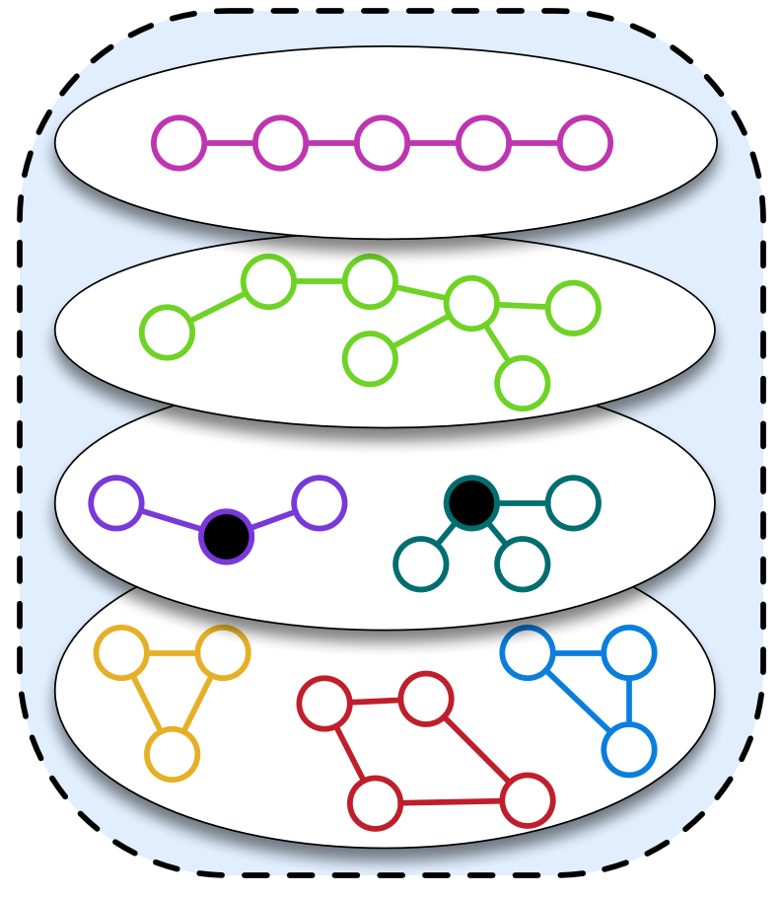
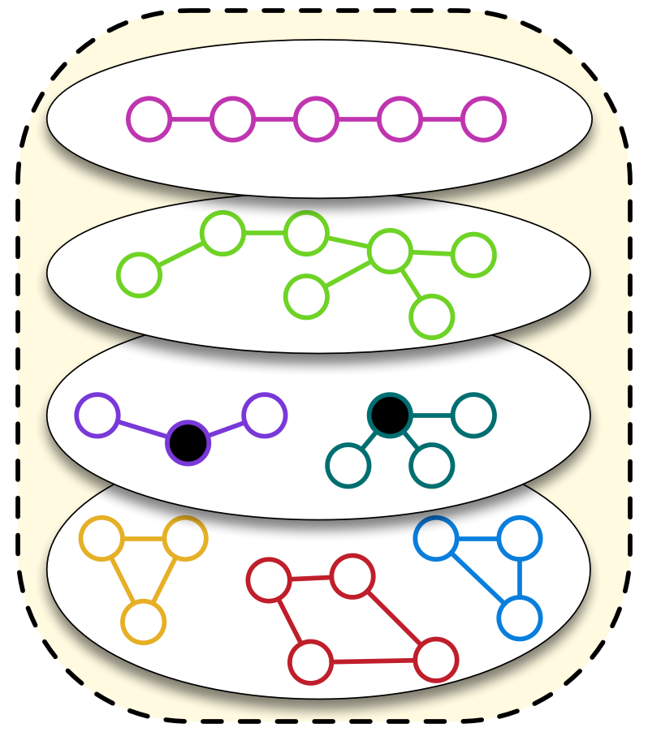
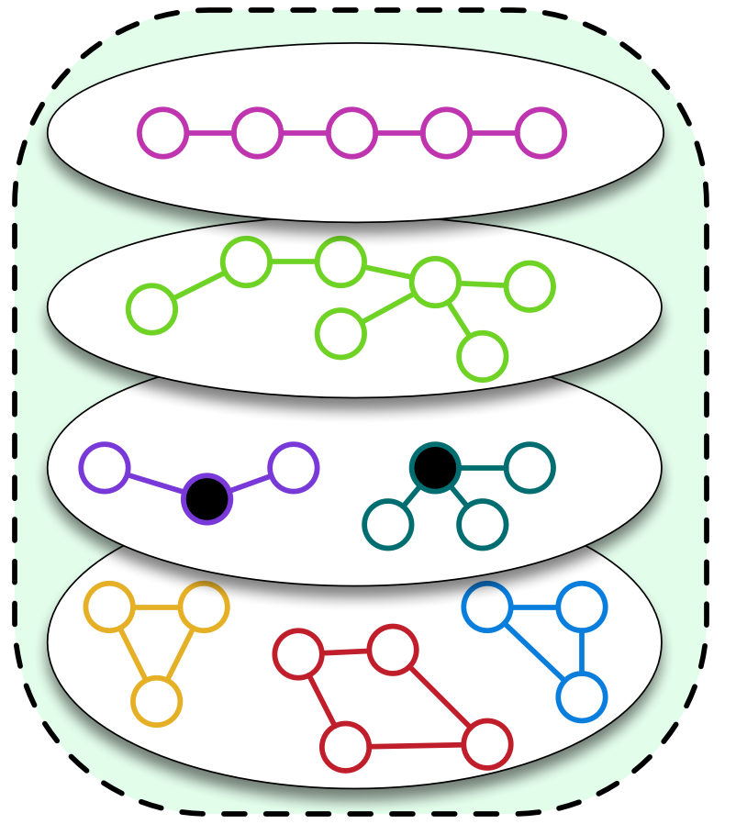
Reasoning With a Meaning Representation
Support Graph creates potential alignments between various semantic abstractions.
Edges reflect similarity / entailment
Question Instance
Question
Paragraph
Candidates
Abductive reasoning
[Peirce, 1883]
QA Reasoning formulated as finding “best” explanation – subgraph connecting the Question to the Answers via the Knowledge
Notes:
Or to go back to the big picture,
this process of discovering the support graph is formulated as a subgraph search problem.
And the job of the optimization problem is to search over all the possibilities and figure out the one that has the best support.
... a type of reasoning that traditionally is referred to as "abductive reasoning".
The research exercise here is to design an model-builder which creates optimization problems for a given question, which achieves this, without pre-specifying the question itself.

Slide 27
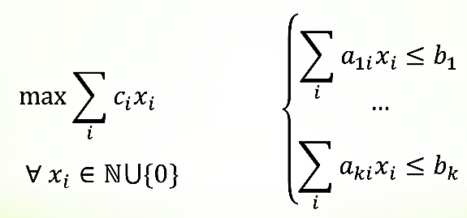
Framework Overview
A discrete optimization approach to QA for multiple-choice questions
Question Q with answer options A
Model Builder
M(G,Q,A)
ILP Engine
Sources of knowledge:
Semantic Representation G
Semantic Representations
Phrasal Entailment
a_{i} ∈ A with support graph + score
Evidence Paragraph
As raw text
Word and short-phrase level entailment / similarity
Optimization using Integer Linear Program (ILP) formalism
M(G,Q,A)
Notes:
Here is how the framework works:
You start with the question;
you have access to the semantic representation of the evidence paragraph.
and you give them to a module that is ILP builder; I’ll describe more what that does.
and it also takes in a phrasal entailment blackbox; which answers simple questions like: “is dog an animal”, is "gravity" a "force", “USA or the United States’, etc.
And given these three inputs, the model-builder comes up with a model which is a combination of the Tables T, Question Q, and the candidate answers A.
At this point we feed it to an off the shelf ILP optimization engine that selects an answer, along what I call “a support graph” as I will explain in the next slides, and the score for that answer.
That’s the whole pipeline of question solving.
This model is an integer-linear program; what this says is, you’re going to maximize an objective with respect to some constraints, and hopefully this will arrive at the right answer.
This a choice, not a necessity; one can replace it with other forms of optimizations.
TODO: Add to the slide a bullet referring to “ambiguity/variability” as it expresses itself in the task of using the KB

Slide 28
ILP Model: Design Challenges
Goal: Design ILP objective function, s.t. maximizing it subject to the constraints yields a “desirable” support graph
Not so straightforward!
Many possible “proof structures”
Imperfect lexical “similarity” blackbox
Partial or missing knowledge
Question logic (negation, conjunction, comparison)
Scalability of ILP solvers
…
Notes:
What are the challenges in formulating such an optimization problem?
It’s not that straight-forward as you might imagine from the previous example. There many proof structures that this definition has to capture:
- The answer might just be a row in a table,
- It could be expressed across multiple tables
- or it could parallel evidence within a table
So we have to come up with flexible-enough design that captures all the variations of such proof structures.
And in addition to this, you have to have mechanism for rewarding the good proofs; but you also have to penalize the system for making spurious connections.
And here you can use the information from lexical similarity box: reward strong links and penalize weak links
But of course, this similarity blackbox is itself is imperfect, as you’d imagine. So you have to compensate for that noise.
Of course you also have to consider question-logic: negations in questions, it might talk about comparisons, etc.

Slide 29
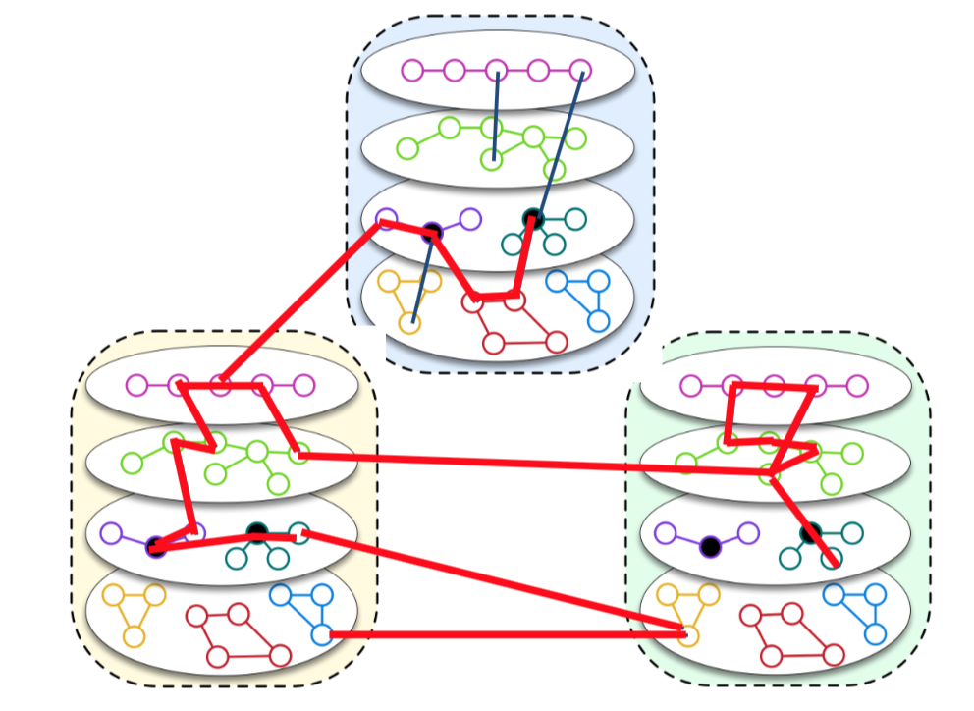
ILP Model: Some Details
Notes:
I am going to give you a high description of what is going on in this ILP optimization and hopefully that will give you enough intuition about what is going under the hood.
There are three key components that we have to define for this optimization problem: ...

Slide 30
ILP Model: Some Details
Variables define the space of “support graphs”:
Each variable corresponds to to a node or edge.
x=1 iff nodes / edges are part of the semantic graph.
Support Graph
Notes:
The variables of this optimization problems correspond to the nodes or edges of the support graphs (if a variable is on, it belongs to the graph).
Collectively, the variables define the space of all the possible support graphs.

Slide 31
ILP Model: Some Details
Objective Function: “better” support graphs = higher objective value
Reward good behavior:
High lexical match links, nearby alignments, using the subject if using a predicate-argument structure, WH-terms (“which of energy …”), etc.
Penalize spurious overuse of frequently occurring terms
Notes:
And the objective function tries to operationalize the intuition that better support graphs get higher scores.
And in order to do that, we have define all the ways that result in the desired behavior:
Reward:
- Strong links can be rewarded; using table headers is probably a good thing.
- More information used, it’s probably a good thing, but you don’t want spurious links (so you can penalize those).
- You reward alignments to the salient terms in the questions; for example, if the question mentions “which form of energy …”, you better pay attention to energy.

Slide 32
ILP Model: Some Details
Dual goal: scalability, consider only meaningful support graphs
Incorporate global and local structure.
Structural Constraints
Meaningful proof structures
connectedness, question coverage, etc.
single/multi-graph, etc.
Semantic Constraints
If using a predicate-argument graphs,
use at least predicate and argument
Notes:
Unlike objective that is about preferences, the constraints enforce hard requirements. They enforce certain properties on local and global structure of the resulting subgraphs.
On the structural side, we want it to be connected, you want to cover the questions,
Or if you’re using parallel evidence proof structure, you have to use the cells that have similar signatures/headers.

Slide 33
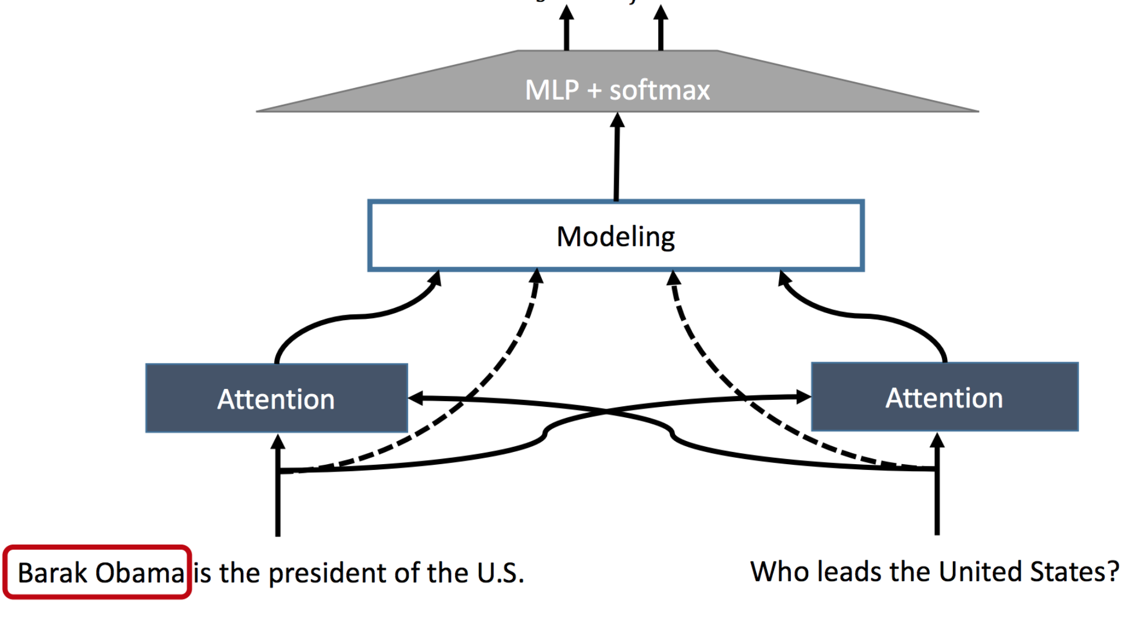


Evaluation: Notable Baselines
Information Retrieval (IR)
Information retrieval baseline (Lucene)
Using 280 GB of plain text
Inference over structure (TupleInf)
Inference over auto-generated short triples
And type-constrained rules
Neural Network (BiDAF)
Attention & LSTM
Extractive, i.e select a contiguous phrase in a given paragraph
[Clark et al. AAAI’15]
[Khot et al. ACL’17]
[Seo et al. ICLR’16]
Type constrained rules: (X, helps in, Y), (Z, has, Y) => (X, helps in, Z)
Thick fur | helps in | cold winter
helps in
Tundra biome | has | cold winter

Slide 34
Empirical results: Science Domain [ZKTR’18]
60
55
50
45
SemanticILP consistently outperforms the best baselines in each case by 3%-5%.
60
57
56
56
55
53
52
52
4th grade exams
8th grade exams
IR
TupleInf
BiDAF
SemanticILP
[Clark et al. 15]
[Khot et al. 17]
[Seo et al. 17]
this work

Slide 35
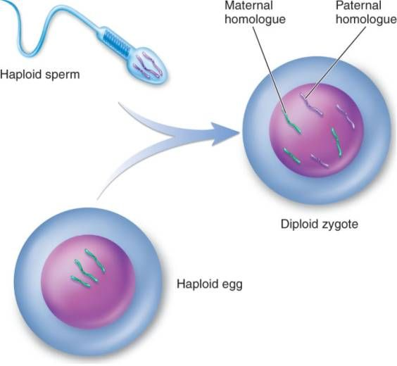
Answering Questions: Biology Exams
Biology exams
Technical terms and answer not easy to find.
Requires understanding complex relations.
[Berant at al, 2014]
We use the same version of our systems across our datasets.
Question: What does meiosis directly produce?
+
(A) Gametes
(B) Haploid cells
Evidence paragraph
… Meiosis produces not gametes but haploid cells that then divide by mitosis and give rise to either unicellular descendants or a haploid multicellular adult organism. Subsequently, the haploid organism carries out further mitoses, producing the cells that develop into gametes….
Notes:
In the biology domain, the questions are heavily based on technical terms. (read the biology question) However the questions are meant to be answerable by average-level English speaker. The main challenge in deriving answers in these questions is that understanding many complex semantic relations.s. Also, the setting is: multiple-choice reading comprehension.

Slide 36
Empirical results: Biology Domain [ZKTR’18]
70
65
60
55
SemanticILP generalizes to a different domain and achieves on-par score with the best domain-specific system.
Domain-specific solver
68
68
64
61
IR
BiDAF
ProRead
SemanticILP
[Clark et al. 15]
[Seo et al. 17]
[Berant et al. 14]
this work

Slide 37
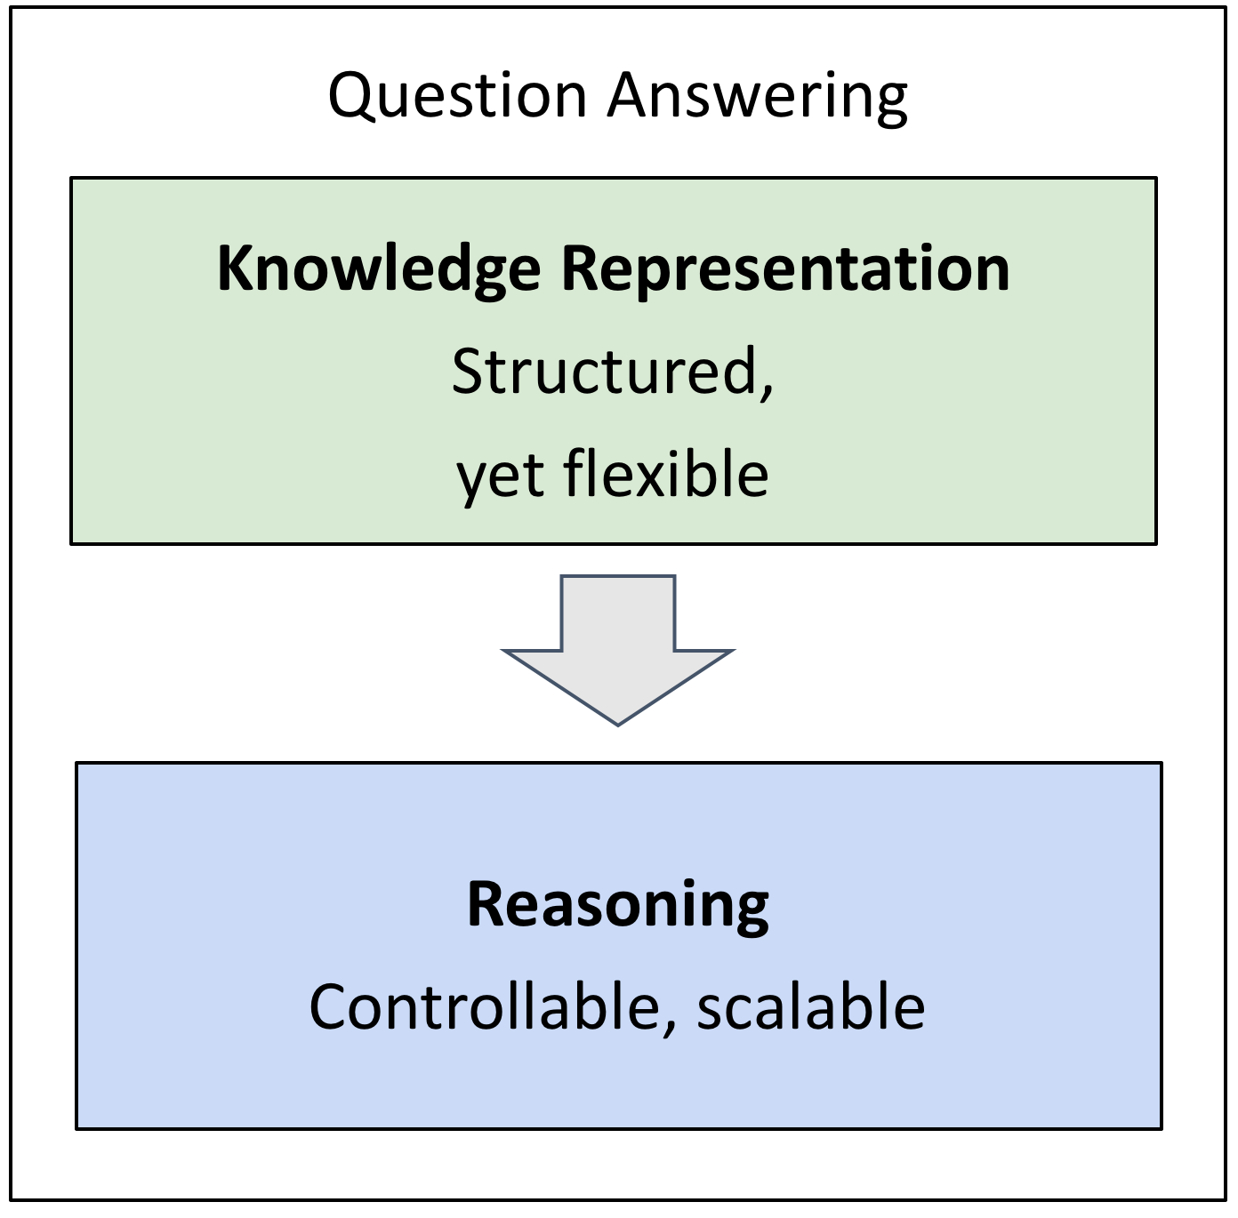
Lessons
Reasoning over language requires dealing with a diverse set of semantic phenomena.
Collection of semantic representations of language, independent of the task (indirect supervision).
Better generalization across two different domains.

Slide 38
ENTITY TYPING with minimal supervision
Zhou, K et al. Zero-Shot Open Entity Typing as Type-Compatible Grounding. EMNLP 18.
Fei, K et al. Illinois-Profiler: Knowledge Schemas at Scale. IJCAI (Cognitum) 15.
Notes:
And this brings us to the second part of the technical content, which is about ….

Slide 39
SEMANTIC TYPING OF ENTITIES
Label mentions with their semantic types.
A handful of professors in the CMU Department of Chemistry are being recognized for their efforts and contributions to the scientific community.
CMU:
/organization
/organization/education_institution
Department of Chemistry:
/organization
/education
/education/department
Notes:
Semantic entity typing.
The input is a collection of mentions in their natural language context.
And the desired output is the semantic type of the indicated mentions.
For instance, in this case CMU should be mapped to … (or any other types that describe this concept)..

Slide 40
Semantic Entity Typing: The Necessity (1)
Dealing with ambiguity
Meaning
Symbol
Our break in Paris was quite memorable.
I met a girl named Paris.
Paris issued a statement condemning the proposal.
city
person
government
Notes:
Why do you need "semantic entity typing"?

Slide 41
Semantic Entity Typing: The Necessity (2)
Linguistic generalization requires “abstractions”.
Ex: Question answering [Yavuz,16]; Information Extraction [Ling,12].
southern
hemisphere
city
northern
hemisphere
city
Which month receives the most hours of daylight in Paris?
“June”
Pittsburgh
“June”
Melbourne
Pittsburgh
Paris
Melbourne
“December”
Notes:
Abstracting over natural language mentions are key to linguistic generalization, typing could help in construction of abstractions.
Let me expand this idea a little bit; take this sample question:
Consider this question: ...
What does it take for a system to generalize to different perturbations of this question? For instance, perturbing "Paris" to "Tucson". A successful system has to be able to understand that these are cities in the northern hemisphere.
In a similar way, I can change this name of the city to "Melbourne" and now the decision has to be updated to ...
And at this point you should be able to see that our hypothetical system would generalize to different variations, only if it is capable of abstracting text and mapping it to appropriate types.

Slide 42
Entity Typing: Existing Work
Multiple datasets for semantic typing
Many datasets, each with distinct semantic types.
domain
Many datasets for other domains.
Law
Biology
[Sang&Meulder,03]
[Hovy,06]
[Weischedel&Brunstein,05]
[Ling&Weld,12]
News
(typical text)
CoNLL
4 types
OntoNotes
18 types
BBN
57 types
FIGER
112 types
granularity
Coarse Typing
Fine Typing
Notes:
Over the years, the field has adopted various definitions for entity-typing.

Slide 43
“Cheap” Typing with Wikipedia
A former Democrat, Bloomberg switched his party registration in 2001.
politician
Entity Linking
businessman
[Ratinov et al. 11]
[Bollacker et al. 08]
philanthropist
Not consistent with the context
Notes:
Wikipedia provides rich information that allows one to infer types easily.
And going beyond to named-entities that don’t exist in the Wikipedia, the approach would fail.

Slide 44
A Common Approach: Supervised Learning
Input: sentence, mention.
Output: a set of types.
A former Democrat, Bloomberg switched his party registration in 2001.
person
politician
Taxonomy is [indirectly] defined during the training time.
Notes:
Such as taxonomies defined this way are not easily changeable.

Slide 45
Zero-Shot Open Entity Typing
Input: sentence, mention
Output: a set of types
, target taxonomy.
(according to the target type taxonomy).
ZOE (Zero-shot Open Entity Typing)
A former Democrat, Bloomberg switched his party registration in 2001.
person
Classifies into a given taxonomy
Target Taxonomy
person
location
organization
Notes:
And here is our proposal, ZOE.
It’s common these days to name models after sesame street characters.
ZOE stands for: …

Slide 46
Zero-Shot Open Entity Typing
Input: sentence, mention, target taxonomy.
Output: a set of types (according to the target type taxonomy).
ZOE (Zero-shot Open Entity Typing)
A former Democrat, Bloomberg switched his party registration in 2001.
person
politician
Open: Classifies into a given taxonomy
Zero-shot: no taxonomy-specific supervision
Target Taxonomy
person
org
politician
doctor
hospital
hotel

Slide 47
ZOE: Type-Compatible Grounding
“Type” as conceptual container binding entities together.
A former Democrat, Bloomberg switched his party registration in 2001.
politician
Richard Nixon
Bill Clinton
Elizabeth Warren
Boris Johnson
Key idea: Determine the type of an input mention by finding entities in the type defining set that share a similar context
company
Lehman Brothers
Reuters
CNN
Google
Notes:
Key question: how do we “understand” what a "type" really means.
Types are conceptual containers that bind entities together to form a coherent group.
I know what a politician is since I know many politicians

Slide 48
ZOE: Type-Compatible Grounding
“Type” as conceptual container binding entities together.
A former Democrat, Bloomberg switched his party registration in 2001.
politician
Richard Nixon
Bill Clinton
ELMo [Peters et al. 18]
Context-consistent
Elizabeth Warren
Boris Johnson
Different contexts where “Elizabeth Warren” is mentioned
Warren is a member of the Democratic Party, after switching party affiliation from the Republican Party in 1996.
company
Lehman Brothers
Reuters
CNN
Google
WikiLinks [Singh et al. 12]
Notes:
Types are conceptual containers that bind entities together to form a coherent group.
I know what a politician is since I know many politicians

Slide 49
ZOE: Type-Compatible Grounding
“Type” as conceptual container binding entities together.
Since its founding, Bloomberg has made several acquisitions.
politician
Richard Nixon
Bill Clinton
Context-consistent
Elizabeth Warren
Boris Johnson
Different contexts where “Berkshire Hathaway” is mentioned
Berkshire Hathaway Berkshire Hathaway Inc has acquired a 25 billion rupees ($356 million) stake in the parent of digital payments company Paytm.
company
Lehman Brothers
Reuters
Berkshire Hathaway
Enron
Context consistency allows us to determine good candidates for type compatibility.
Notes:
Types are conceptual containers that bind entities together to form a coherent group.
I know what a politician is since I know many politicians

Slide 50
Zero-Shot Open Typing: Big Picture
A former Democrat, Bloomberg switched his party registration in 2001.
A mention & its context
High-level Algorithm:
Map the mention to context-consistent Wikipedia concepts
Rank candidate titles by context-consistency and infer the types according to the type taxonomy.
Mapping type-compatible Wikipedia entities
Richard Nixon
Bill de Blasio
Elizabeth Warren
person
mayor
person
politician
politician
politician
president
person
scholar
Inference: aggregate and rank the consistency scores.
person
politician
official

Slide 51
Zero-Shot Open Typing: Big Picture
A former Democrat, Bloomberg switched his party registration in 2001.
A mention & its context
Resources
Mapping type-compatible Wikipedia entities
Richard Nixon
Bill de Blasio
Elizabeth Warren
[Bollacker et al. 08]
person
mayor
person
politician
politician
politician
president
person
scholar
Contextualized
Representations
WikiLinks
[Singh et al. 12]
Inference: aggregate and rank the consistency scores.
[Peters et al.18]
person
politician
official
Notes:
Or if you want to want to think about it I terms of the resources used:
you use Freebase types as your set of universal types
you use the concepts included in Wikipedia.
You use Wikilinks to extract contexts for each concept
And contextualized representations
And all of these resources are available independent of the task or datasets you want to solve. In fact, almost all of them have been around for many years.

Slide 52
Empirical Results: Fine-Typing [ZKTR18]
Outperforms supervised system in cross-domain.
Comparable results with supervised systems.
System | Trained on | Evaluated on
 |  | FIGER | BBN | Ontonotes
AFET [Ren et al. 16] | FIGER | 66 | ? | ?
NFETC [Xu&Barbosa 18] | FIGER | 79 | ? | ?
AFET [Ren et al. 16] | BBN | ? | 75 | ?
AAA [Abishek et al. 17] | BBN | ? | 79 | ?
AFET [Ren et al. 16] | Ontonotes | ? | ? | 65
NFETC [Xu&Barbosa 18] | Ontonotes | ? | ? | 70
ZOE (this work) | - | 71 | 75 | 61

Slide 53
Lessons
Reformulating the task and using weak signals helps us reduce our dependence on direct “supervision”.
This type-aware approach leads to the ability to transfer across domains & taxonomies.
politician
Richard Nixon
Elizabeth Warren
Domain A
Domain B
Notes:
We studied the problem of entity typing and we came up with a framework that is not dataset-specific.
And we achieved this by appropriate reformulation of the problem and use of indirect supervision.
And I showed that this type-aware approach leads us to better domain-transfer across datasets AND taxonomies.

Slide 54
Beyond Supervision-rich “tasks”
We will never have enough annotated data to train all the models for all the tasks.
Annotation for complex tasks is difficult, costly and sometimes impossible.
We don’t even know what are “all the tasks”.
Notes:
Taking a few steps back, as I argued in the introduction, it’s unlikely that we will have enough annotated data for *all* the tasks and abilities. - annotation could be difficult, in new contexts, users, settings.
- in fact, not we don’t even know all the tasks.
Going beyond supervisio-rich problems is necessary if we want to scale up our current systems.

Slide 55
Beyond Supervision-rich “tasks”
Two samples of research projects in an attempt to utilize hints in data to infer supervision signals:
Representation
Structure
Not just two systems:
Initial steps towards a broader theory of using “incidental” signals.
[Roth, AAAI’17]
Notes:
And here we showed two early instances of how this can be done, by effective use of (1) representation & (2) reasoning [problem formulation].
And I want to emphasize that these are just two "systems"; but rather evolving parts of a more general methodology.

Slide 56
BIG PICTURE + LOOK AHEAD
Notes:
In the first part of the talk I am

Slide 57
Natural Language Processing
Semantics
Semantic Role Labeling, Name Entities, Semantic Language models, Coreference, etc.
Learning & Inference
Question Answering, Textual Entailment, etc.
Machine Learning, Optimization & applications
ZKCR. EMNLP’18
KCRUR. NAACL’18
FKPWR. Cognitum’15
PKR. NAACL’15
KKSR. AAAI’18
KKSR. CoNLL’17
CEKSTTK. AAAI’16
KKSR. IJCAI’16
KSKCSSR. StartAI’18
KKCMSR. COLING’16
QK. NourIPS’15
KNJF. TIP’14
NKTNJ. SMC’11
NLP tools/software
K et al. LREC’18
SCKKSVBWR. LREC’16
Notes:
My research focus covers two important topics:
- My home base is natural language processing, which has been the main focus of this talk.
- Beyond this, I have contributions in "Machine Learning" from algorithmic and system-design perspective.
- Within my main focus, I have worked on various aspects and sub-areas, such as ...
(today's talk where two cherry picked instances from these classes problems)
And to make sure our research has impacts outside academia, I have invested time on making sure we produce high-quality resources and software.
And finally a newfound interest of mine is a family of problems under "information pollution".
This is not only an application of NLP research, but also derives the research in these areas.
And for the rest of my talk, I am going to focus on this problems, it's importance and potential for future.

Slide 58
Beyond Supervision-rich “tasks”
A major shift in the field:
Being able to make use of massive loads of unlabeled data in the form of language models.
Compatible with the philosophy I advocated for here.
⬤ | ⬤ | ⬤
⬤ | ⬤ | ⬤
⬤ | ⬤ | ⬤
ELMo
[Peters et al.18]
… vacation in Paris …
Other works:
[Devlin et al.18; Radford et al.18]
Notes:
A major shift in the field is due to the models that are pre-trained on massive freely available text.
which is compatible with the philosophy I advocated for here.
=======
One of the future directions I am excited about is inspired by recent successes in the field.
…
And just to be clear, these successes are compatible with the philosophy that I was advocating for here.
In fact, in the 2nd part of the talk, such systems as a part of our semantic typing project.
And in particular, … .

Slide 59
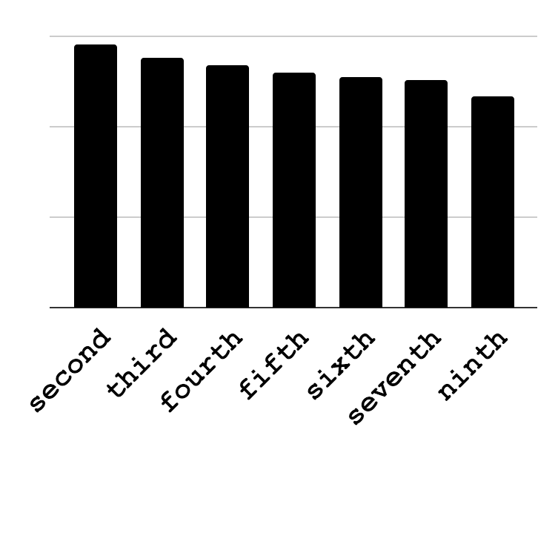
Language Models: Means to Access Knowledge
They let you “query” for knowledge:
⬤ | ⬤ | ⬤
⬤ | ⬤ | ⬤
⬤ | ⬤ | ⬤
ELMo
[Peters et al.18]
… vacation in Paris …
Other works:
[Devlin et al.18; Radford et al.18]
Pittsburgh is the ____ -largest populated city in Pennsylvania.
Notes:
So far, the field has been using such models in a few narrow sense; for instance taking their results and using them as features in your feature-rich machine learning models.
However, one thing that I am excited about is that, such models let you directly look into what is inside them, with explicit queries, in the form of natural language.
For instance, I can issue queries like this about the size of Pittsburgh and it comes back a response like this.
In a sense, what it gives me is a distillation of many pattern that it has seen on the web, possibly about Pittsburgh.

Slide 60
Language Models: Means to Access Knowledge
What is known:
What is the nature the knowledge that they have internalized?
Know what you know:
Is there a mechanism to decide whether something is [not]?
Inference with knowledge:
Access what is known and be able to solve bigger problems.
Pittsburgh is the ____ -largest populated city in Pennsylvania.
Notes:
And in order to be able to effectively use such models, one needs to ...

Slide 61
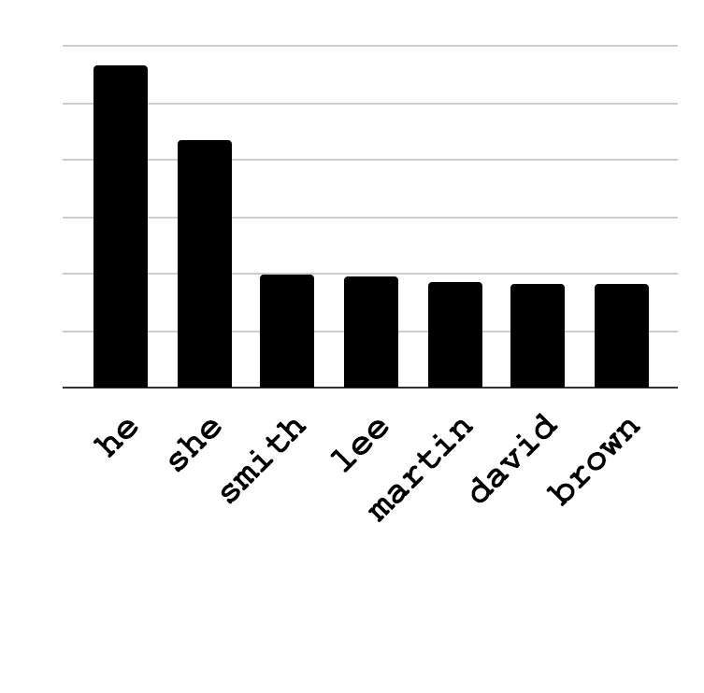
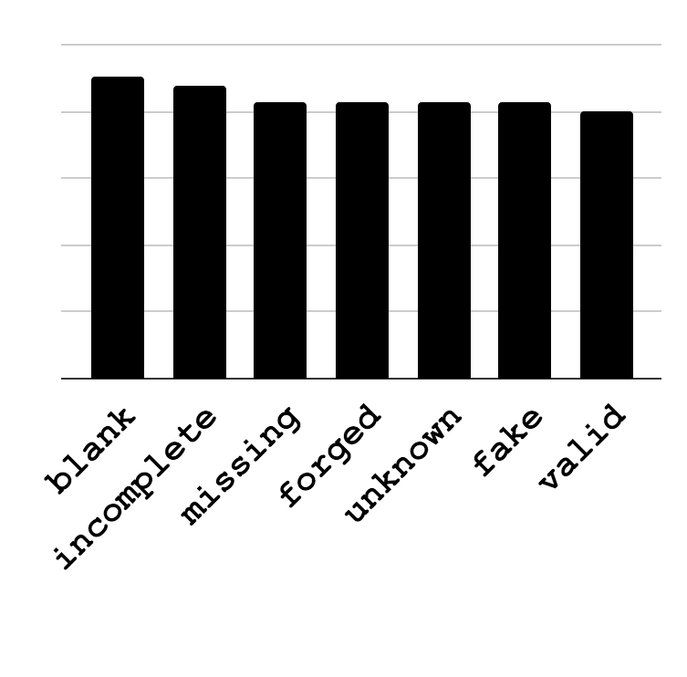
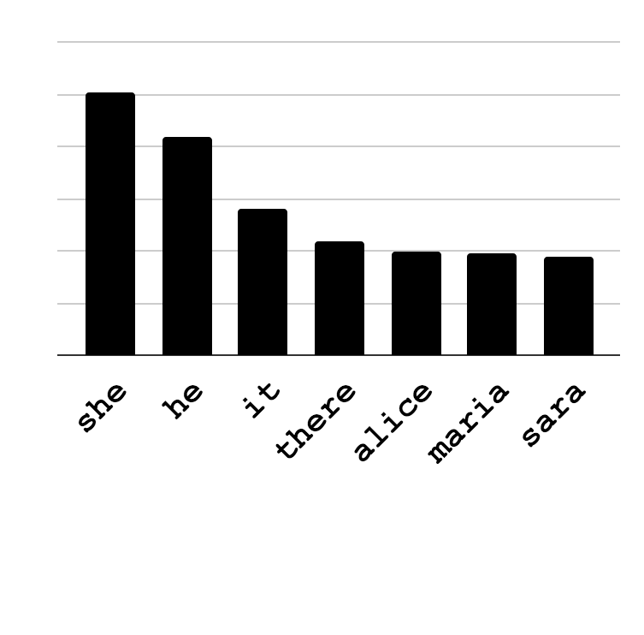
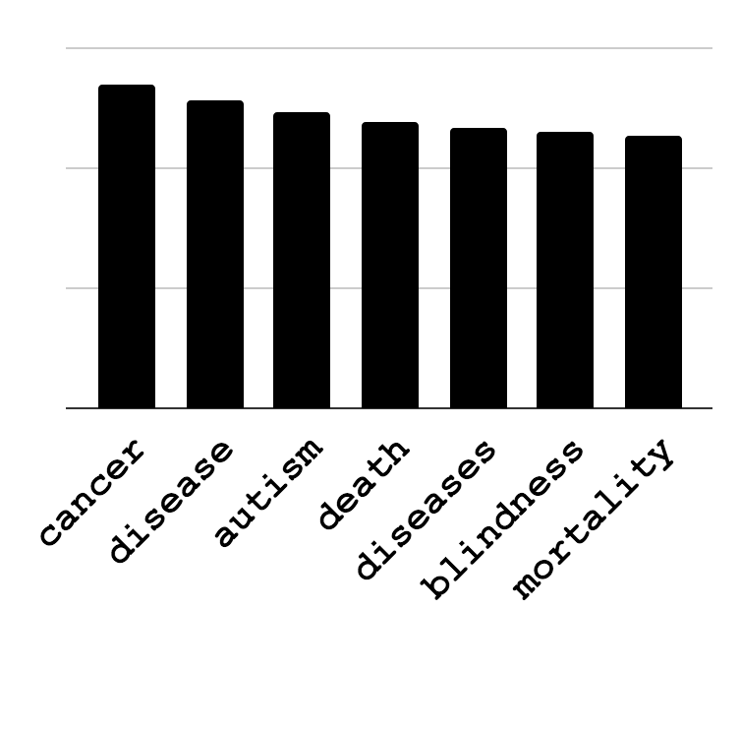
Language Models: Biases
___ is a lawyer.
Obama’s birth certificate is ___.
What does this mean for the NLP systems built out of such systems?
Discovery:
How can we automate the discovery of issues?
Mitigation:
How can we resolve the such biases?
___ is a babysitter.
Vaccines cause ___.
Bias
Conspiracy Theories
[May et al.19; Zhao et al.19]
Notes:
Trained on web data: it shouldn't be of surprise if they are sexist, racist, etc.
Using this *ist model for NLP tasks, what does it entail?
Does this mean my QA system is going to be *st?

Slide 62
Natural Language Processing
Semantics
Semantic Role Labeling, Name Entities, Semantic Language models, Coreference, etc.
Learning & Inference
Question Answering, Textual Entailment, etc.
Machine Learning, Optimization & applications
ZKCR. EMNLP’18
KCRUR. NAACL’18
FKPWR. Cognitum’15
PKR. NAACL’15
KKSR. AAAI’18
KKSR. CoNLL’17
CEKSTTK. AAAI’16
KKSR. IJCAI’16
KSKCSSR. StartAI’18
KKCMSR. COLING’16
QK. NourIPS’15
KNJF. TIP’14
NKTNJ. SMC’11
NLP tools/software
Information Pollution
K et al. LREC’18
SCKKSVBWR. LREC’16
CKWCR. NAACL’19
Notes:
And speaking of "false information", I am gonna go back to the big picture and introduce a newfound interest of mine:
a family of problems under "information pollution".
This is not only an application of NLP research, but also derives the research in these areas.
And for the rest of my talk, I am going to focus on this problems, it's importance and potential for future.

Slide 63
Information Pollution
Information Technology started with much optimism:
Democratizing information and greater liberties.
Few foresaw the huge radical impact of the information revolution.
Massive amount of Information pollution:
“The contamination of the information supply with irrelevant, redundant, unsolicited, incorrect, and otherwise low-value information.”
[Levent Orman'15]
Notes:
When information technology was about to embark a few decades ago, it started with much "hope" and positivity.
- The hope of democratizing information.
- Giving access to information to people who wouldn't have had otherwise.
What happened in practice was very different from what was expected: we ended up with massive amounts of polluted information.
Which resulted in radicalizing our societies and endangering our most-basic societal institutions.
- You have seen it in US elections, Brexit and many other places as we speak.

Slide 64
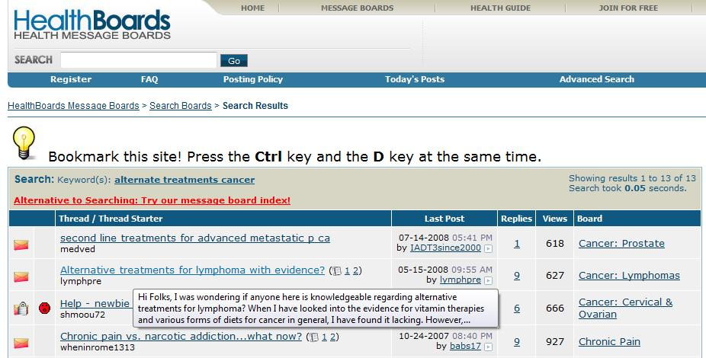

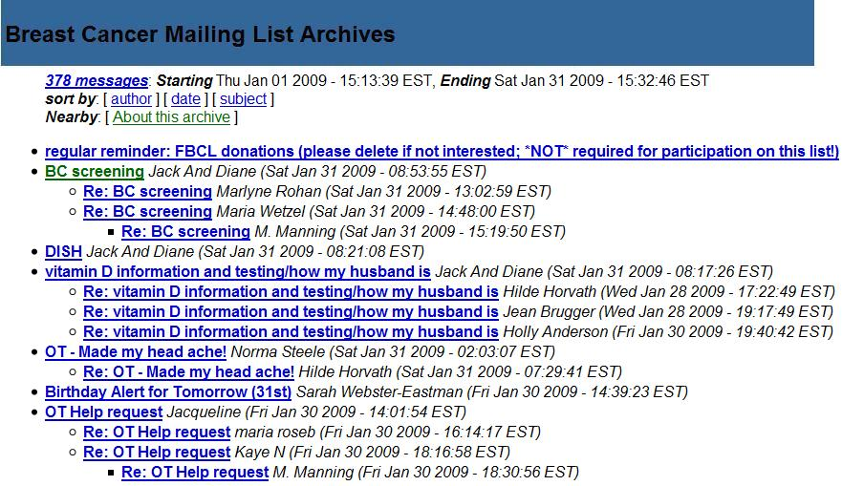
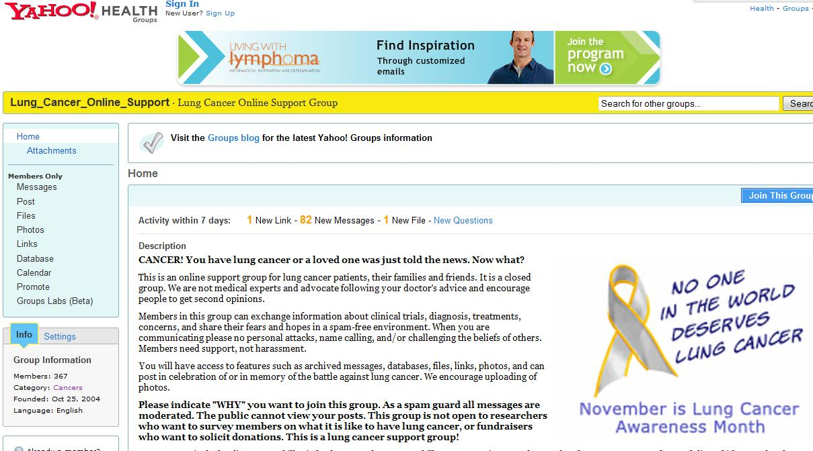
Information Pollution: Not Just Politics
Medical Domain, Education, Public Policy, etc.
“Best treatment for X;” “Side effects of X .”
Are they consistent?
Are they trustworthy?
Are they written by someone with an agenda?
Notes:
The reach of this phenomena is way beyond politics.
- Every single days thousands of (of not 10s of thousands) of people, go to the we and search queries like ...
- But as micro-consumers of information, we have no ideas whether: ...

Slide 65
Information Pollution: Not Just Fact-Checking
Many issues don’t have a single “answer.”
“Should X be legalized?”
Possible answers are subject to situations, world views or background.
Moral, utilitarian, libertarian, philosophy, etc.
Factual information (or lack of) is not really the core of the problem.
Notes:
Another factor that makes this challenging is that ...
And both of these view could be reasonable under certain world-view.
In other words, calling this problem "fake news" challenge is a grave over-simplification.

Slide 66
Information Pollution, as NLU Problems
Understanding Sources
But what should we believe, and who should we trust?
Sources may
Have their own, often hidden, motivations
Make different or even contradictory claims
Understanding the evidence
Sources may present different, but legitimate, perspectives
Most interesting issues/questions have multiple “right” answers
Perspectives must be supported by evidence
Not only applications for NLP, but also drive the research in important directions.
Notes:
Connecting this to natural processing, there two axes along which I think we use NLP to address such problems:
1. Understanding of sources
2. Understanding of evidences
➔ 1. What should we believe; who should we trust; understanding of agendas and motivations.
→ 2. Are the evidences to a claim make different or contradictory claims? Or maybe there are multiple perspectives to an issue?
These are not only are applications to NLP, they also derive the research.
And tying it back to the story I started with, it's unlikely that you can learn this creating massive annotated data:
There are nuances to claims and perspectives that you can't exhaustively cover all of them.
================
Think about two two newspapers that describe hurricane; one can describe it as what happened, and the other one can describe it in relation to climate change.
These two actually describe two different views of the world, and by their world selection, they deliver different messages.

Slide 67
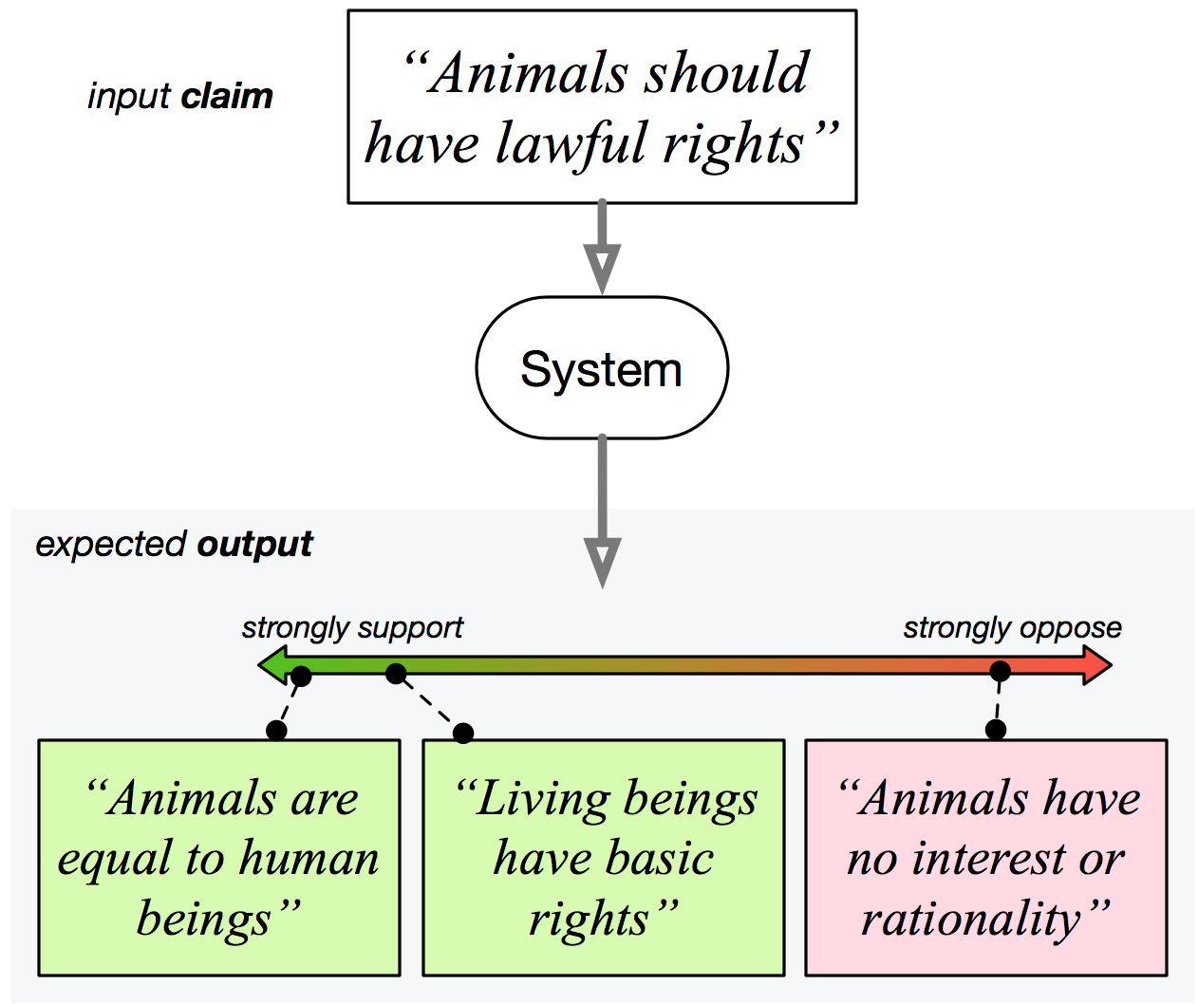
Discovering Diverse “Perspectives”
Our recent work: provide users with the understanding that each “story” has more than one “perspective.”
Goal:
Perspectives could give a fuller understanding of an issue.
Make us more open-minded, less afraid & more likely to consider other views.
[Chen, K, et al. NAACL’19]
Notes:
In our recent work in this direction, we view the world as “perspectives.
The goal is to give the readers the understanding that each story, really has more than one perspective. It’s not black and white.
We want, as I show it here, given a claim, a system to go to pools of perspectives (in principle, all of the web) and give me all the perspectives addressing this claim, some supporting it and some against it.

Slide 68
Information Pollution: an NLU Challenge
Suffering from this pollution is not a forgone conclusion.
A computational model that will help us navigate the polluted world.
Natural Language Processing/Understanding + Algorithmic Components
Collaborative efforts involving experts from the social sciences, policy, and others.
Overreliance on fully annotated data, unlikely to solve the problem.
Interesting challenge, important, and will have societal impact.
Notes:
We shouldn’t take this information pollution as something that we have to live with; we should be able to address these problems.

Slide 69
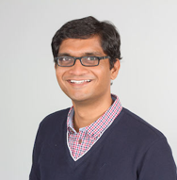
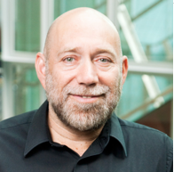
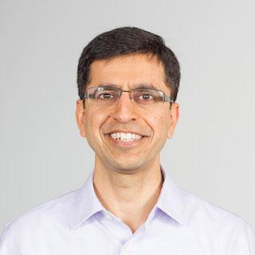
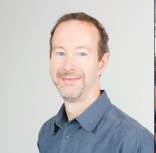

Tushar Khot
(AI2)
Dan Roth
(UPenn)
Ashish Sabharwal
(AI2)
Peter Clark (AI2)
Chen-Tse Tsai
(Bloomberg)
Ben Zhou (UIUC → UPenn)
Notes:
Before I finish I want to give credit to everyone who have helped and inspired me in this work.
And thank you to you for being here.

Slide 70
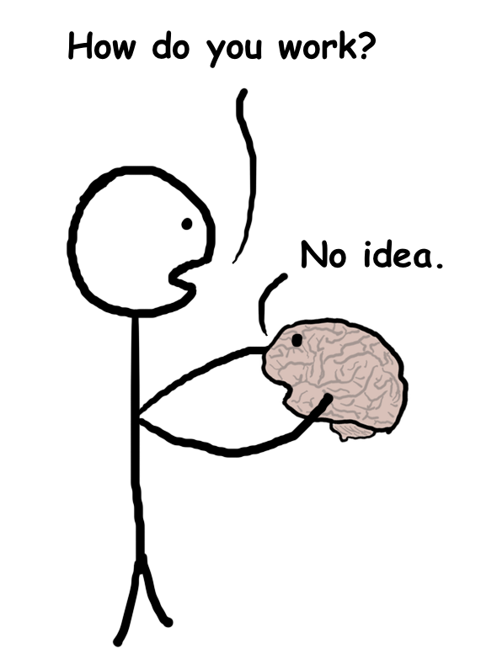
That’s it, folks!

Slide 71
Natural Language Processing
Semantics
Semantic Role Labeling, Name Entities, Semantic Language models, Coreference, etc.
Learning & Inference
Question Answering, Textual Entailment, etc.
Machine Learning, Optimization & applications
ZKCR. EMNLP’18
KCRUR. NAACL’18
FKPWR. Cognitum’15
PKR. NAACL’15
KKSR. AAAI’18
KKSR. CoNLL’17
CEKSTTK. AAAI’16
KKSR. IJCAI’16
KSKCSSR. StartAI’18
KKCMSR. COLING’16
QK. NourIPS’15
KNJF. TIP’14
NKTNJ. SMC’11
NLP tools/software
K et al. LREC’18
SCKKSVBWR. LREC’16
Theoretical
Empirical
Notes:
My research focus covers two important topics:
- My home base is natural language processing, which has been the main focus of this talk.
- Beyond this, I have contributions in "Machine Learning" from algorithmic and system-design perspective.
- Within my main focus, I have worked on various aspects and sub-areas, such as ...
(today's talk where two cherry picked instances from these classes problems)
And to make sure our research has impacts outside academia, I have invested time on making sure we produce high-quality resources and software.
And finally a newfound interest of mine is a family of problems under "information pollution".
This is not only an application of NLP research, but also derives the research in these areas.
And for the rest of my talk, I am going to focus on this problems, it's importance and potential for future.

Slide 72
TableILP: major weaknesses
Problem | Example | A Solution
Missing the entailment entailment between concepts and events | sleet ⇒ form of precipitation snow ⇒ form of precipitation | support parallel evidence
ignores info about answer type | which month, which form of energy | which-term boost
poor identification of important words | “evaporation”, “digestion”, “photosynthesis”, “gravity” | essential terms boost
ignores relation between words | “ruler” measures “length”, “sunlight” typeOf “light energy” | semantic relation matching
treats answer as a single word | “from solid to liquid”, “from liquid to solid” | use answer structure

Slide 73
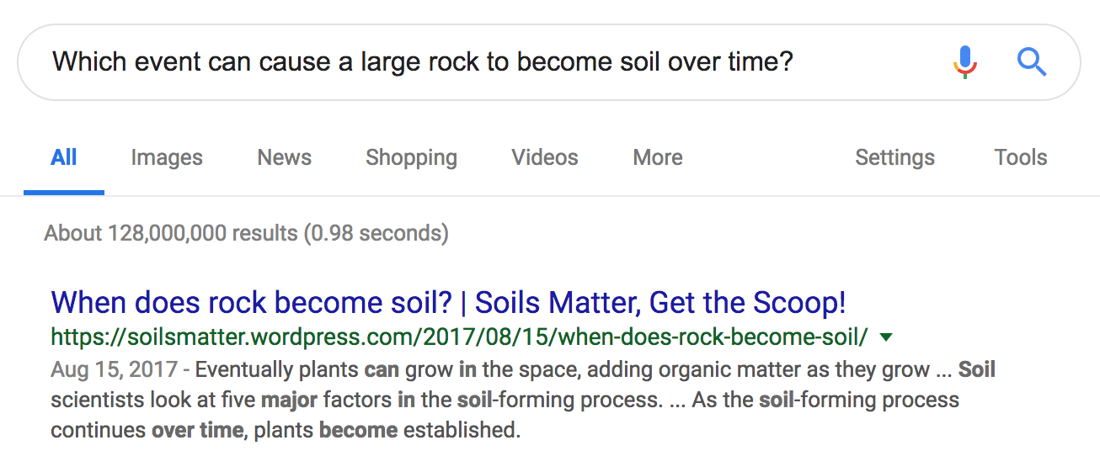
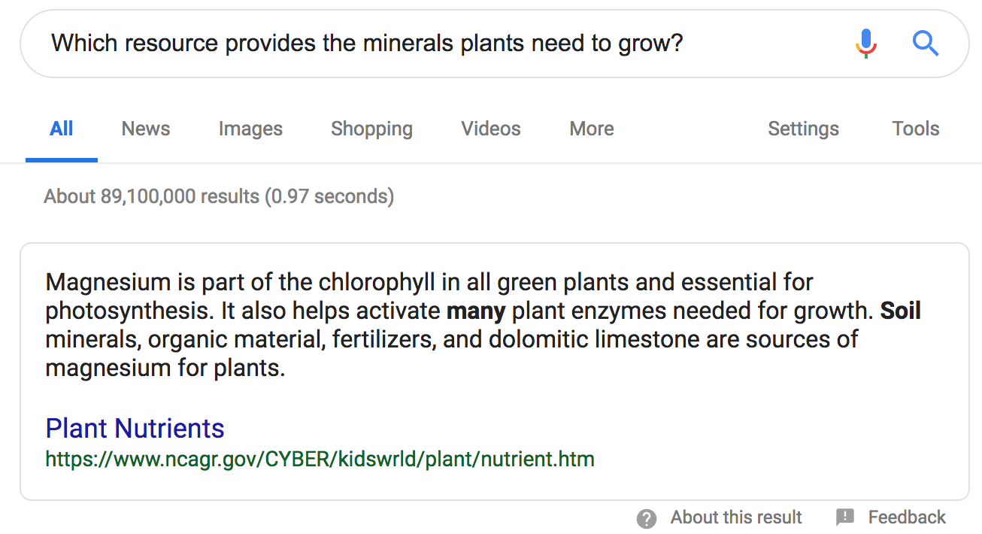
Example outputs
TableILP
IR
Which event can cause a large rock to become soil over time?
(A) decaying
(B) an earthquake
(C) a landslide
(D) weathering
Which resource provides the minerals plants need to grow? (A) sunlight
(B) water
(C) soil
(D) air
Notes:
”minerals” can only be in “soil”.

Slide 74
Troubling Trends
Weak generalization across datasets
Dataset A
100
50
0
87
49
[Yin et al. 18]
Dataset B
SNLI
RTE-5
[Bowman et al. 15]
[Bentivogli et al. 09]
Notes:
In a similar vein, many of our SOTA systems have shown difficulty in transferring across datasets.
You train a create system for dataset A, you get close to 90%, cool almost solved;
But now you evaluate on Dataset B and your performance is almost close to random.

